Slide 1
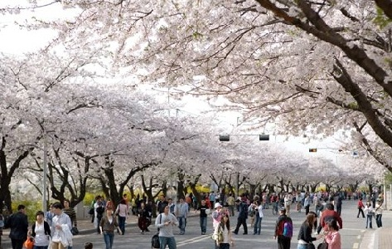
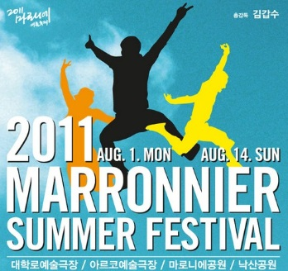
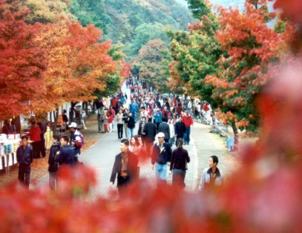
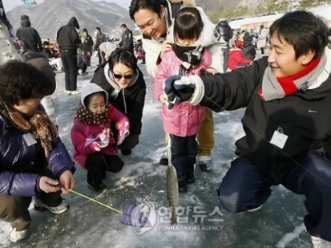
Festival in Korea
Ahn Ji Yeon

Slide 2
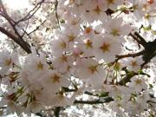
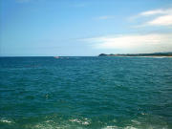
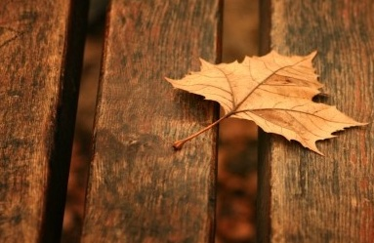
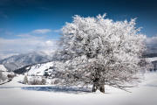
Introduce
As you know, Korea has four seasons.
(spring, summer, fall and winter)
What do you think is the most famous festival in Korea?
I will explain to you about seasonal festival in Korea.

Slide 3
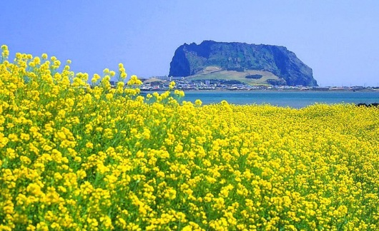
Festival of Spring
Here is the cherry blossoms festival in Yeouido and the rape blossoms festival in Jeju.
Every spring, many people gather to see the flowers. Next year, if you have free time, you’d better join that festival. Then you can feel that fresh and nice view.

Slide 4
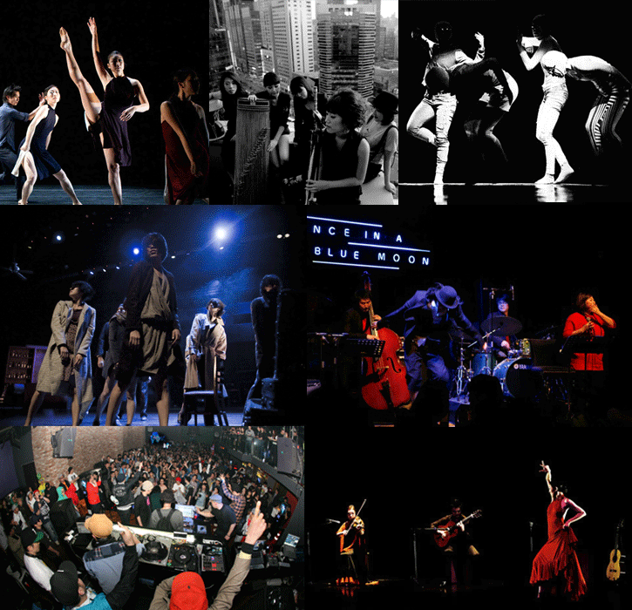
Festival of Summer
Summer is hot like passion. Marronnier Summer Festival was started until last year in the Dae-hak Street in Seoul.
This place has iconic culture and art. If you join the play, dance and music in here, you can see various attraction and feel that youth and passion.

Slide 5
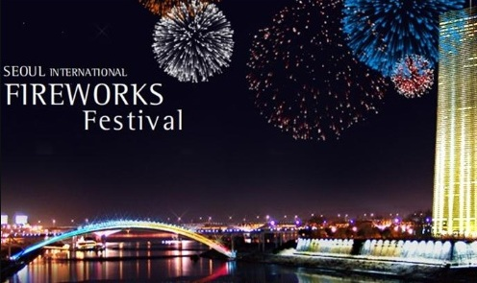
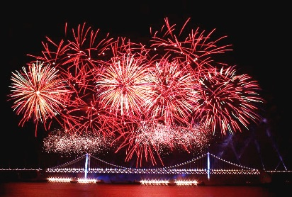
Festival of Fall
Fall is noted for the glorious tints of its autumn foliage. Many people plan to go mountain climbing to see the scenery of the beautiful mountains. The hills are ablaze with autumnal tints.
International Fireworks Festivals are held annually in October in Busan and Yeouido. If I have a chance, I really want to go to this festival. The night view is said to be amazing.

Slide 6
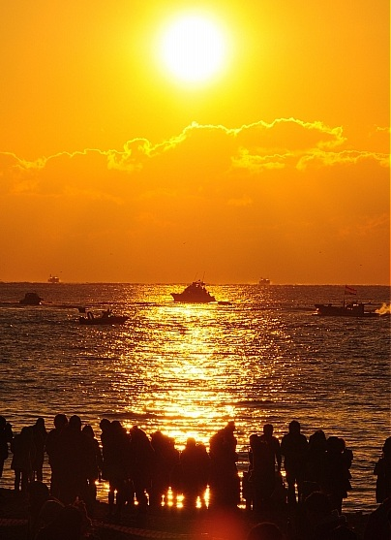
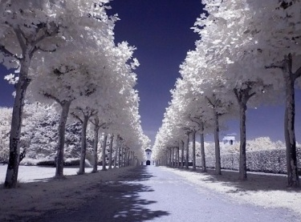
Festival of Winter
People come to the east coast to see the sunrise on January first and pray “I wish you all the best in the coming year.” Also winter is famous for other festivals, especially Snowflakes and ice fishing festivals. If you plan to travel, check for updated information. There is much to see in Korea.

