Slide 1
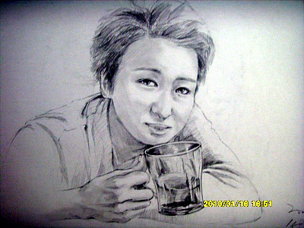
My Best Works
Chae Youngwoon

Slide 2
This is a painting done in oils. I think ART is a tool to express human’s emotions.
This year, I couldn’t go to see cherry blossoms.
I thought it’s so sad that I couldn’t see them. That day
I thought ‘Next week the cherry blossoms will be gone.’ So I want to remember it before they are gone.

Slide 3
I love paintings of peoples, or at least the paintings that capture the playful action. I like just drawing more than using paints. So often, the picture is filled with black because of pencil.
This picture is one of my favorites, the man in the picture is a Korean Hockey player. When I first met him personally, I gave him this picture which captured the moment he made the winning goal.

Slide 4
This man is just one of the people who sat on the bench in the park. I often draw someone, who I even know well.
Oneday I went to the park and saw a certain foreigner. He looks so sorrowful. I don’t know the reason but, I wanted to recorded that moment in the form of pictures.

Slide 5
This is one of my portfolios.
I want to make my display space, so took a photo of my pictures and made them smaller.
I intended this work to look like an exhibition.

Slide 6
I drew this picture during the summer vacation.
I went to the library and looked through magazines. I draw this after that.

Slide 7
This is the latest picture. This man is the same as in the second picture.
The reason I drew this is because of what he said.
He told me “I’m in a slump recently.” so I wanted to encourage him, at least at the moment when he saw this picture.

Slide 8
This is one of my practical skill assignments for my major class.
This kind of picture is called ‘Corrugated cardboard picture’ because it is drawn on corrugated cardboard.
When I tried to completed this, it took so many times and effort.
I felt like my eyes were crossed.

Slide 9
This sort of picture’s name is ‘pointillize.’ This is one of my major assignments too.
When the professor gave this assignment, he said the topic was free. I wanted to draw roses, and draw them because I think a rose is a perfect flower which has a nice shape.

Slide 10
This is my major assignment. By using fabric. When I see lace, I think about a beautiful lacy wedding dress so I made the day of a wedding.

Slide 11
I like this picture because I spent so much time with this. This picture is…maybe one of my portfolio.
I draw many things naturally and when it is completed it looks like a horse.
I never meant to make a ‘Horse shape’ at first, I just drew freely.

