Slide 1
Names in Canada

Slide 2
Family names
Most family names come from historical professions
Smith (blacksmith, 대장장이)
Miller (mill worker 제분업자)
​Cooper (barrel maker 통 만드는 사람)
Taylor (clothes maker 재단사)
Clark (priest 성직자)
​Parker (park keeper 주차하는 사람)
​Campigotto (8 fields 8개의 밭을 가진 사람)

Slide 3
Family names and Immigration
Many immigrants to Canada / America changed their family names when they arrived in the early 1900s
Immigrants also chose English names when going to school
My grandfather, Guido, changed his name to William to sound more English/Canadian
We didn’t know his original name was Guido until he died

Slide 4
Given Names
Most people have 2 given names, a first name and a middle name
Many given names come from parents, grandparents, etc.
My middle name, William, comes from my grandfather
Names ending in ‘son’ traditionally were used to indicate who the father was. This isn’t true anymore.
Eg. Jackson = son of Jack, Jefferson= Son of Jeffery

Slide 5
Names and Gender
Most names have a specific gender (male/female)
For many names there is a male and female version
Very few names could be male or female but a shortened version could be either.
Male Female
Terry Teri Michael Michelle
Patrick Patricia

Slide 6
Marriage and Children
Most women take their husband’s family names when they marry
Some women use a hyphen (-) to just add their husband’s name to their name
Eg. Susan Jones marries John Smith= Susan Jones-Smith
Children usually take their father’s name
When women divorce they go back to their family name

Slide 7
Top Baby in Canada, 2015
Girls
Emma
Olivia
Sophia
Zoe
Emily
Boys
Liam
Jackson
Logan
Lucas
Noah

Slide 8
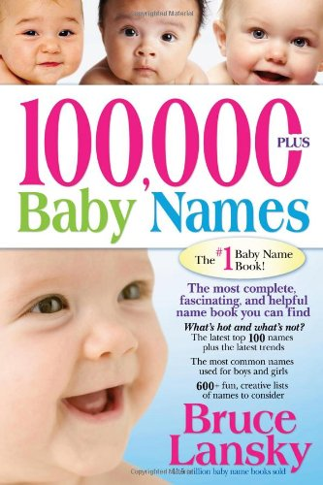
Babies Names
Babies names come from family members, pop culture, people you admire or meanings from baby books
Kevin = Kind, Gentle, Handsome
Sarah = Princess
Teri = Harvester
My daughter Teri’s name comes from the name of my favorite author, Terry Pratchett

