Slide 1
Widgets
A task-based course in practical English

Slide 2
Introducing Your Survey

Slide 3
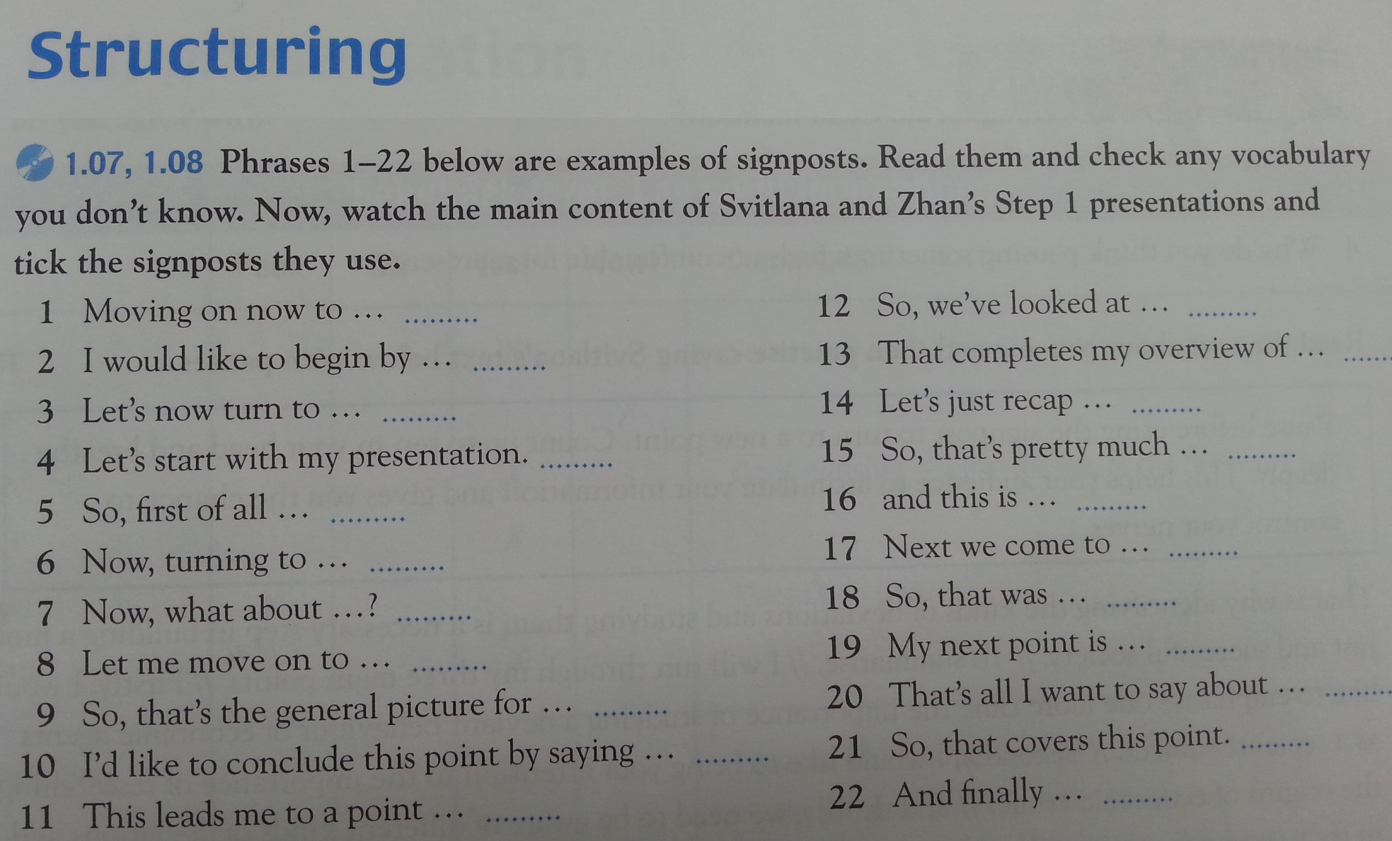
Transitioning

Slide 4
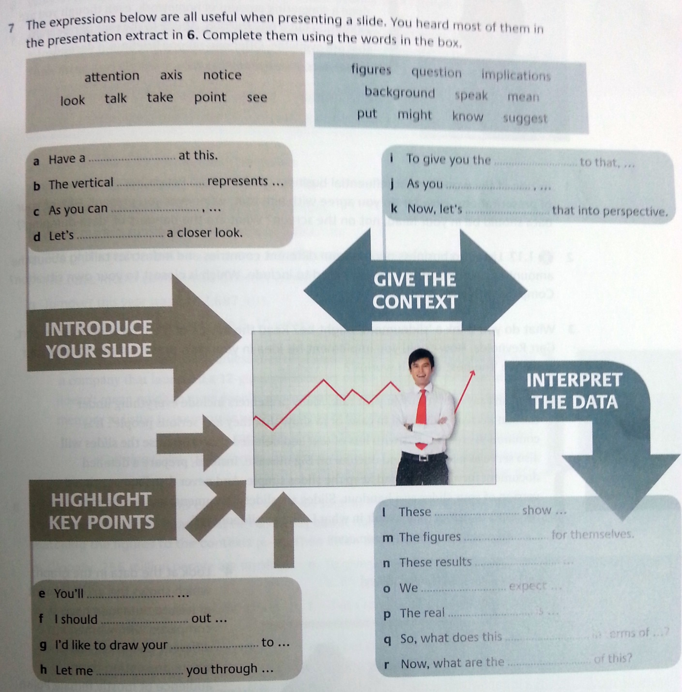
Explaining Slides

Slide 5
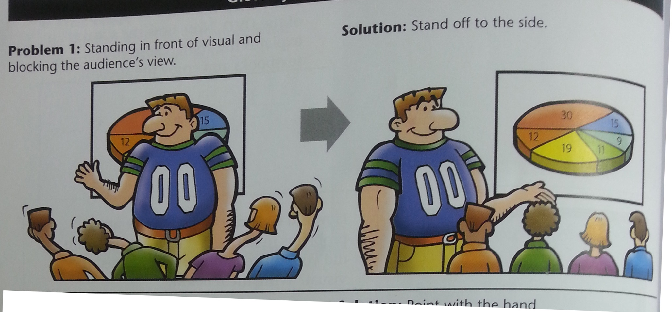
Problems with Slides

Slide 6
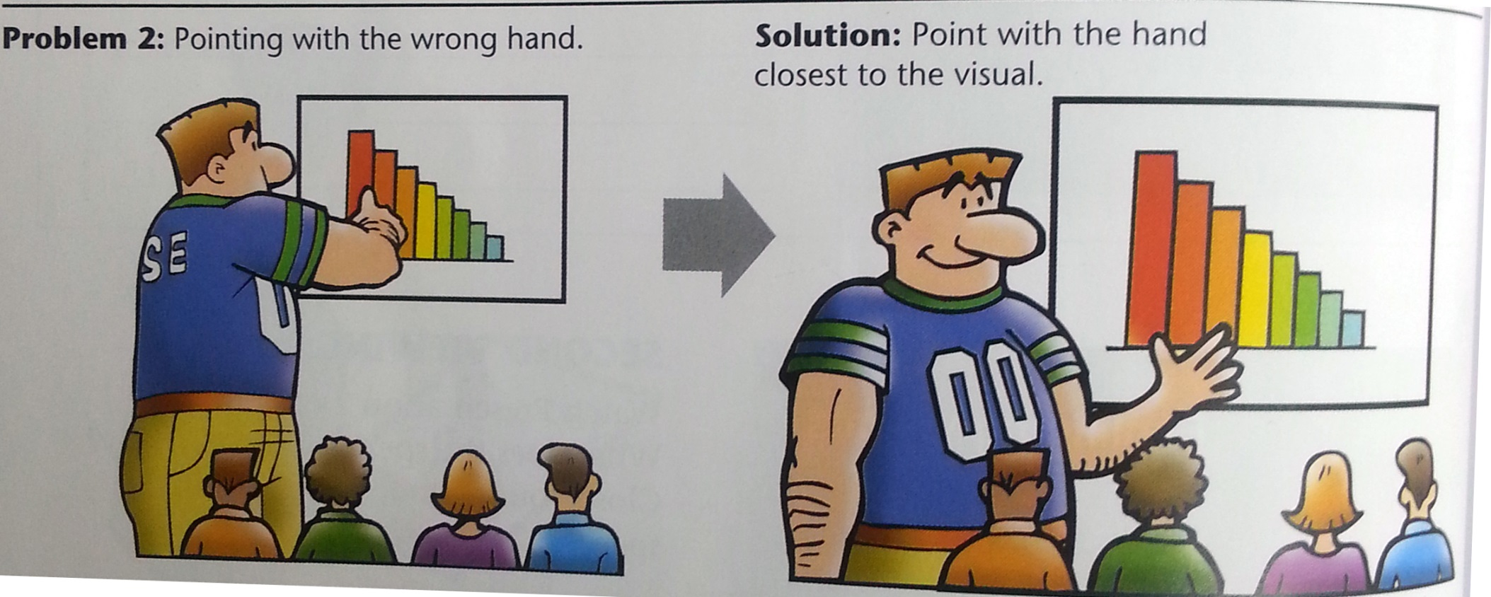
Problems with Slides

Slide 7
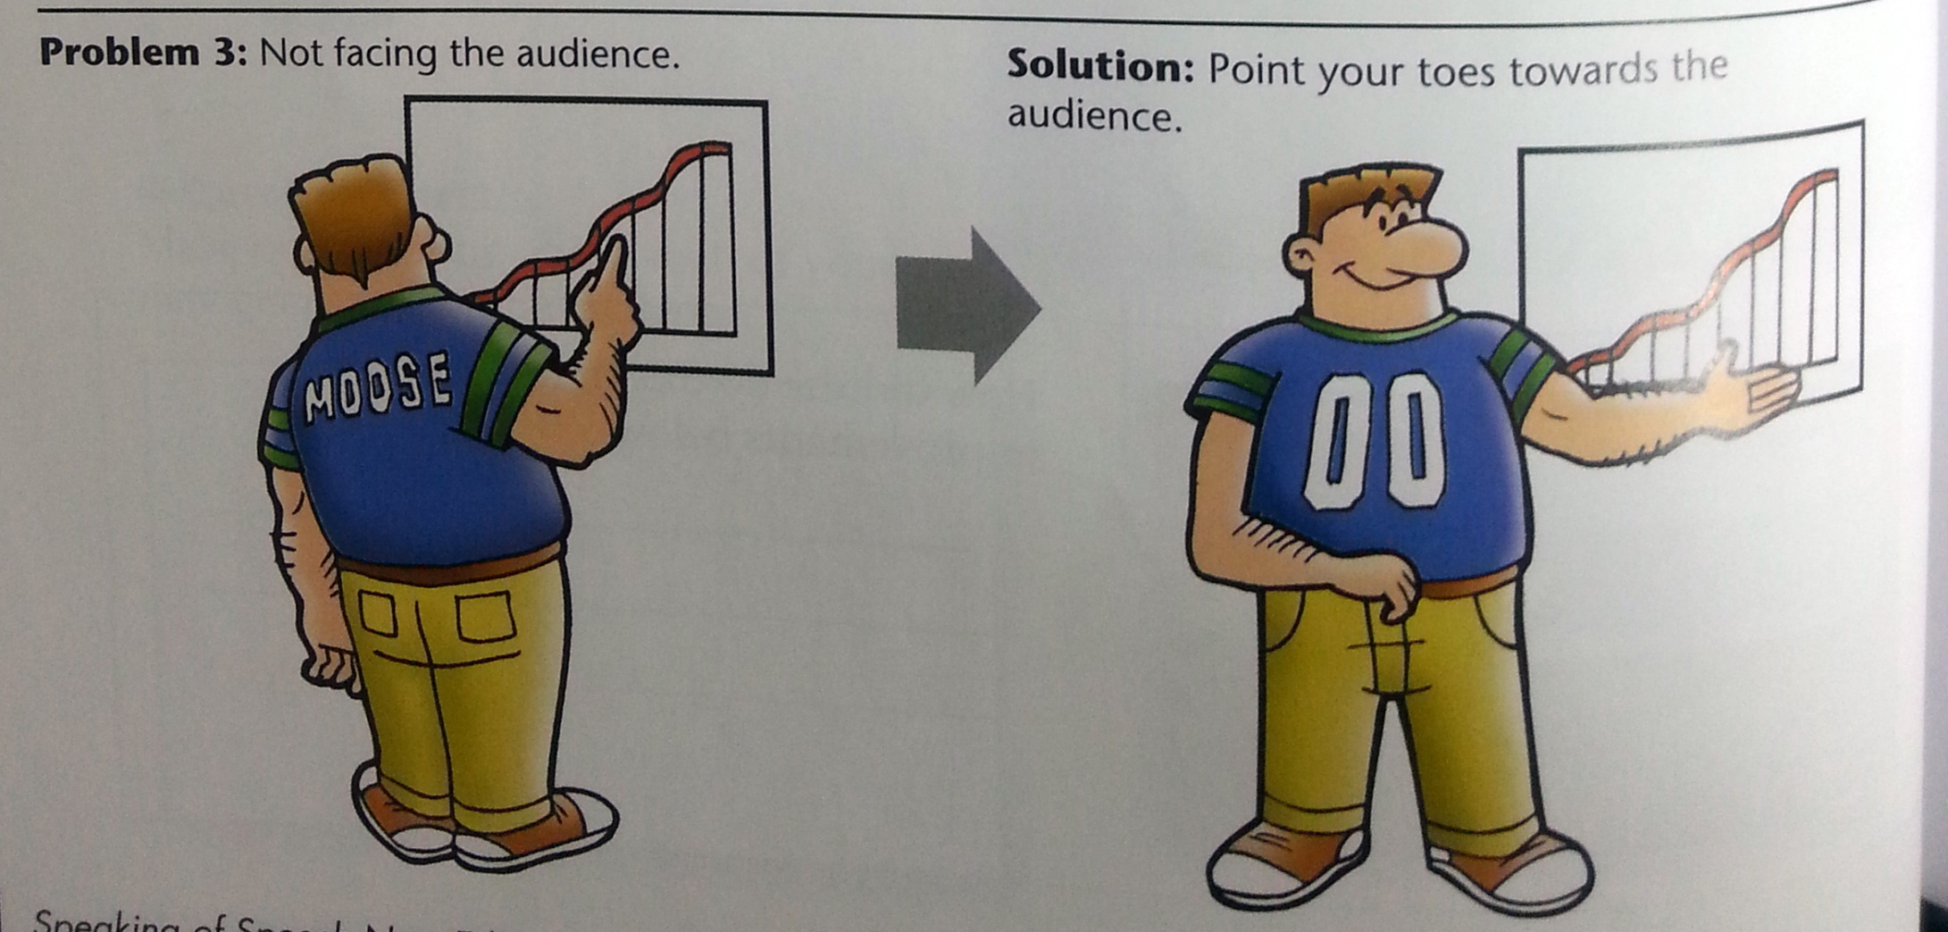
Problems with Slides

Slide 8
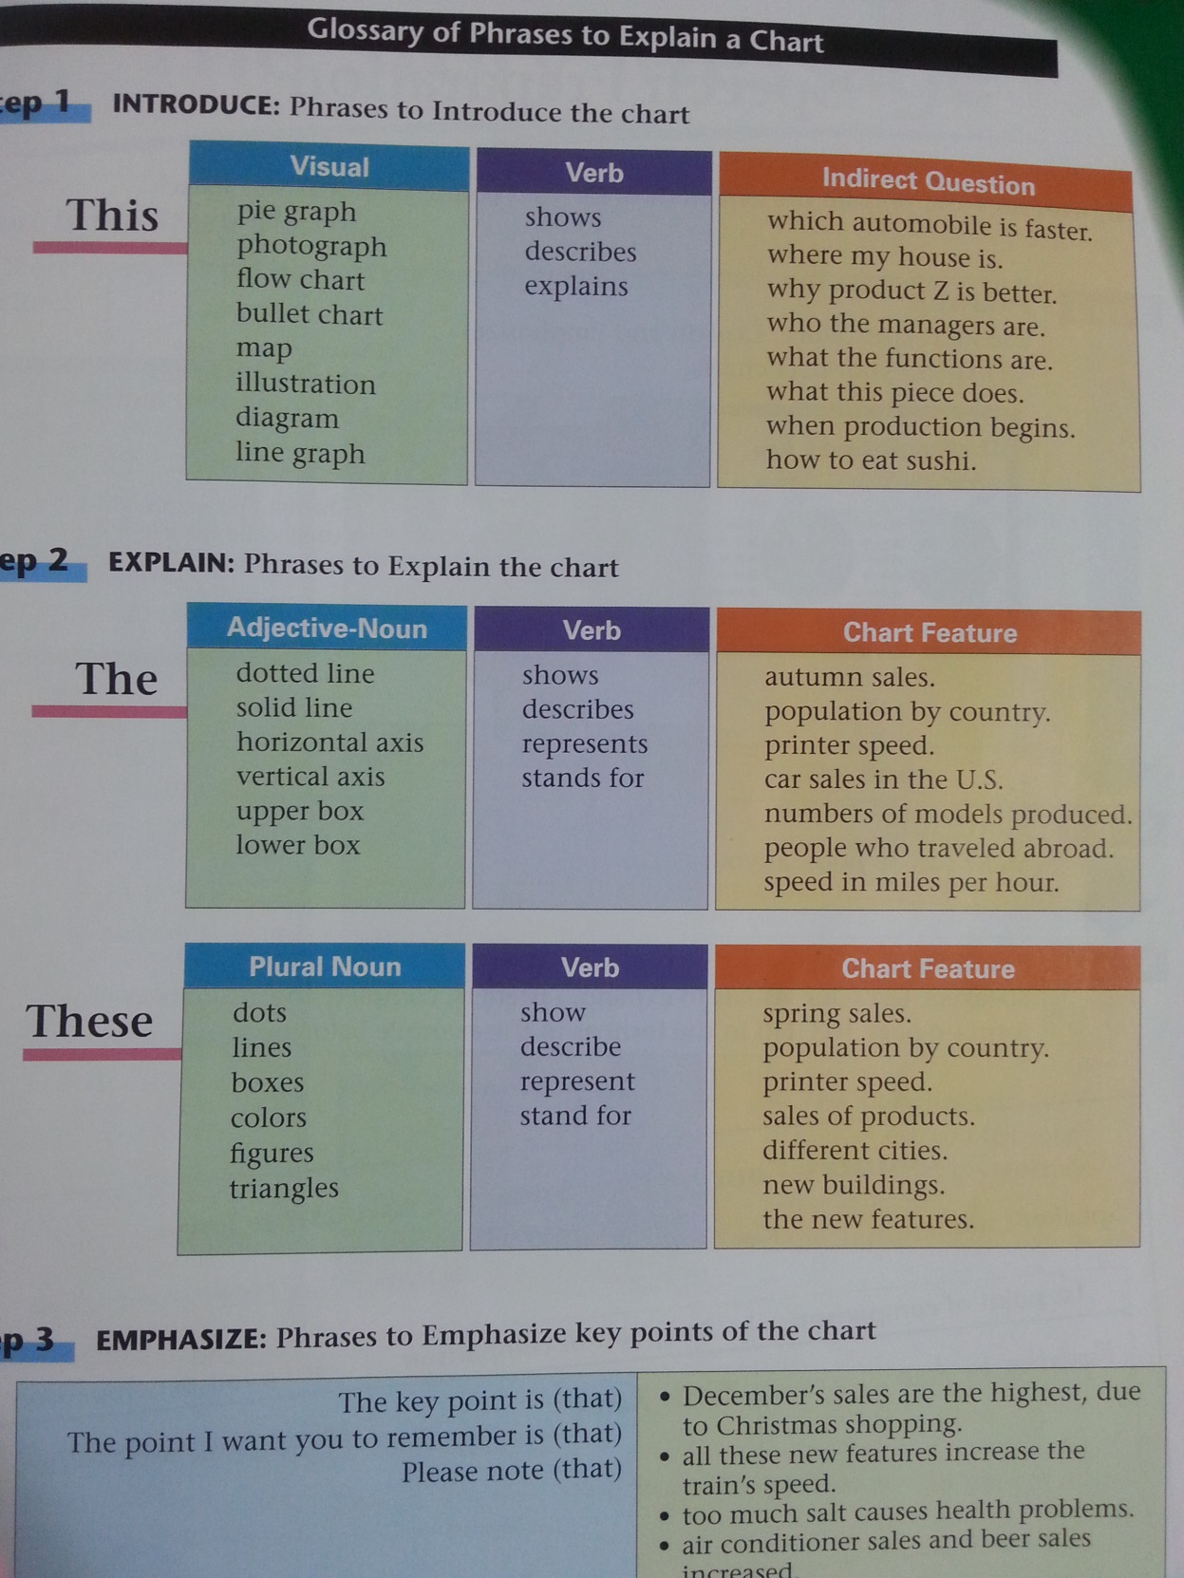

Slide 9
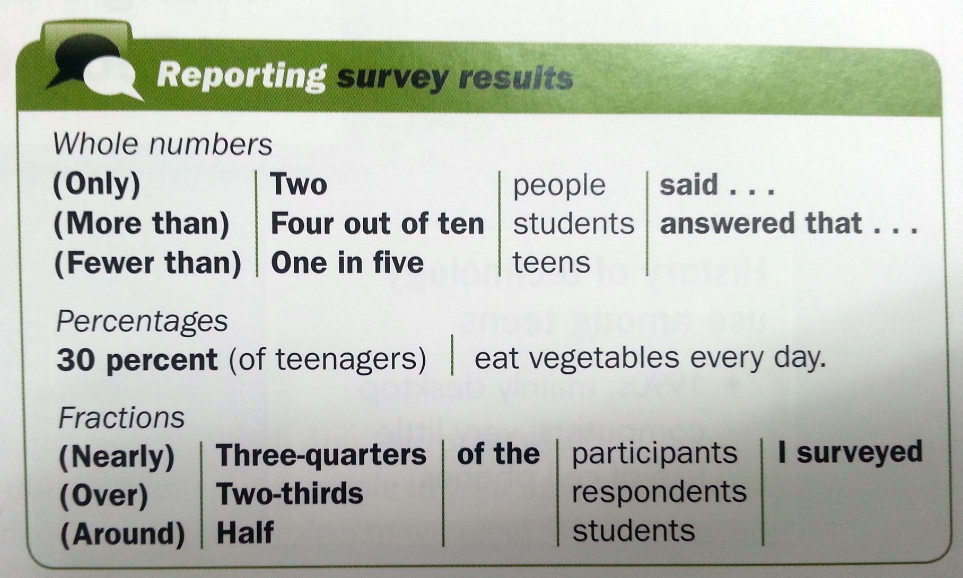
Reporting Your Numbers

Slide 10
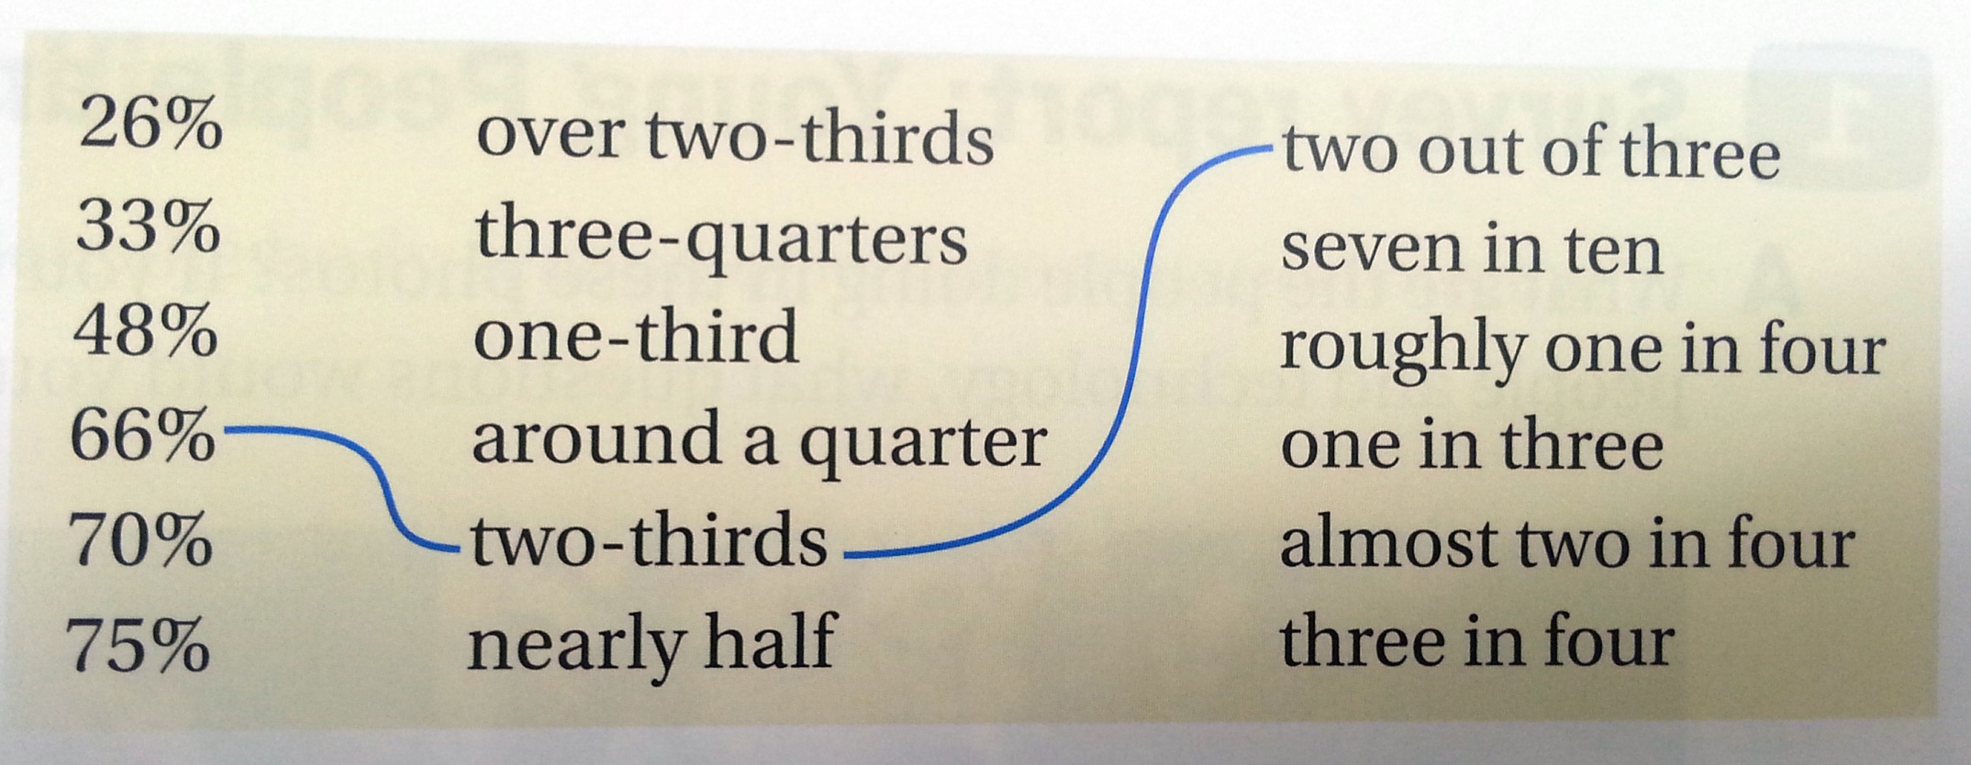
Reporting Your Numbers

Slide 11
Emphasizing Key Information

Slide 12
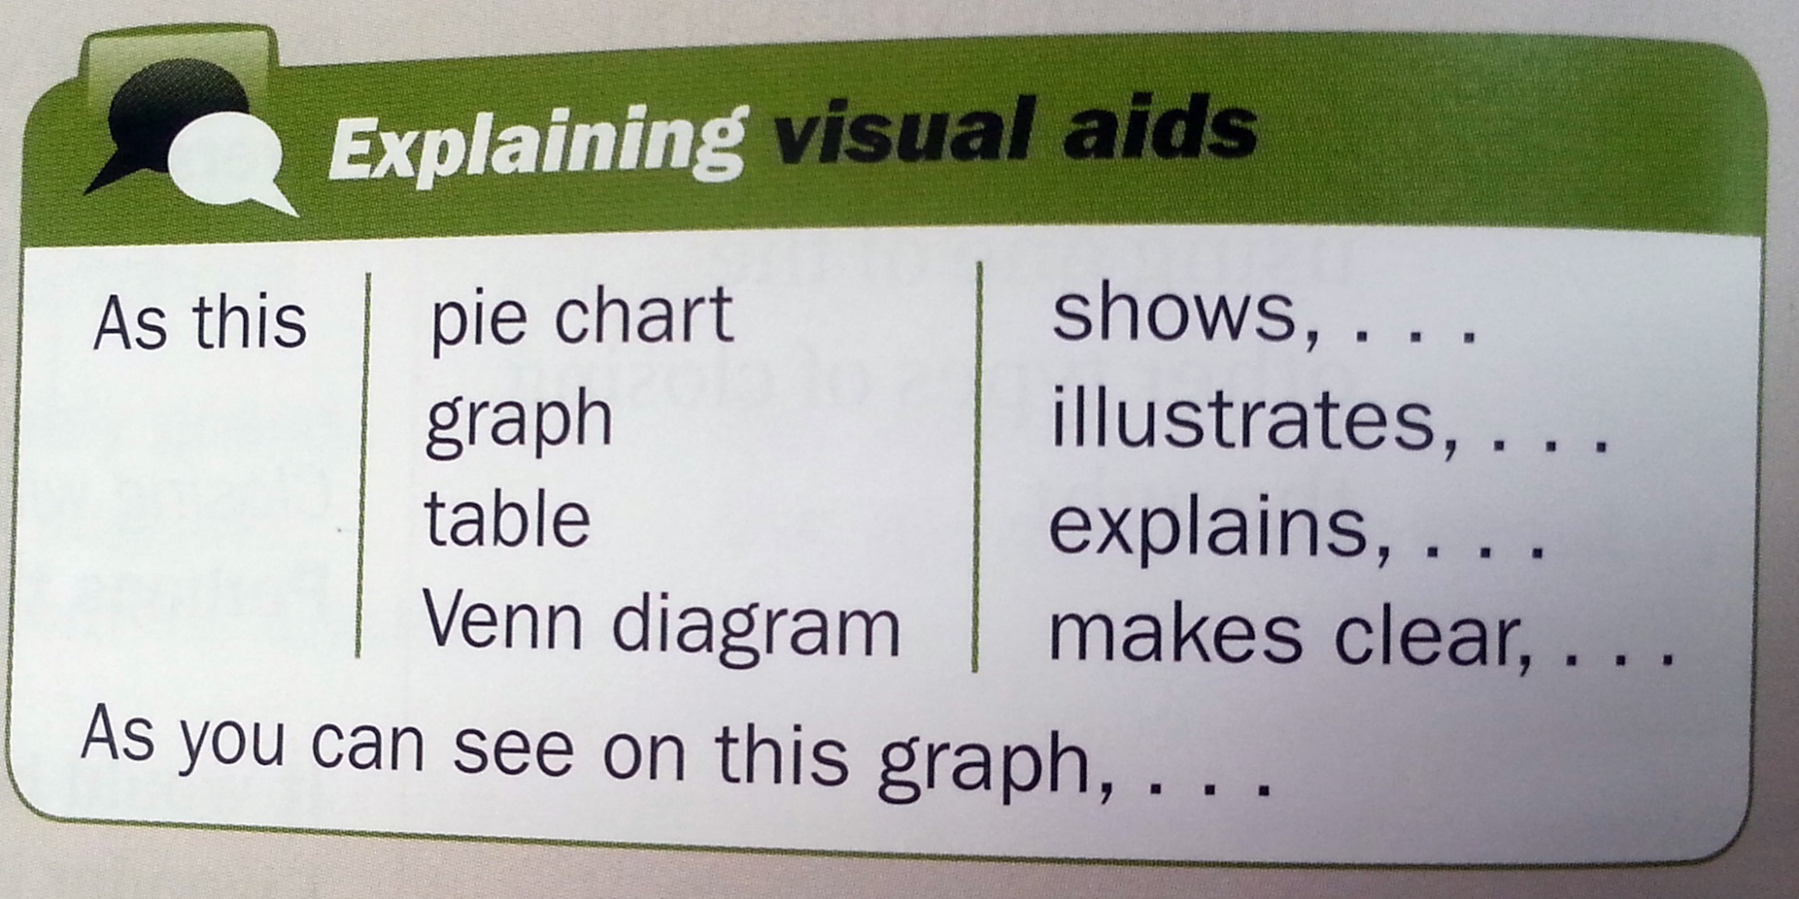
Explaining Your Visuals

Slide 13
Concluding Your Presentation

